Slide 1
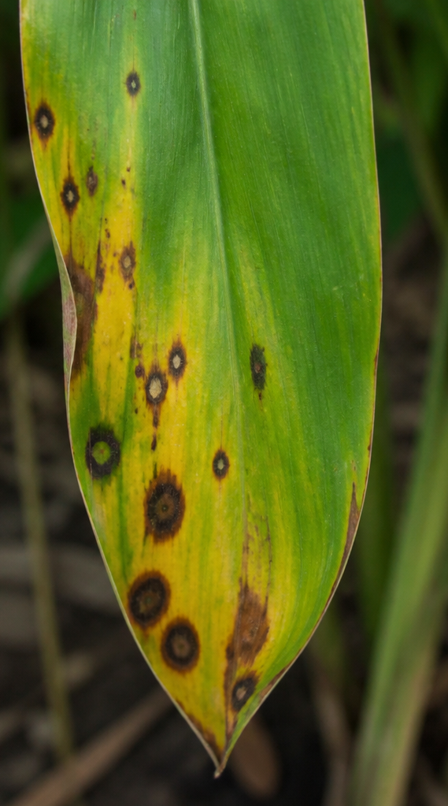
Cardamom Leaf
Disease Detection
Using Deep Learning
An Explainable AI Approach with EfficientNetV2 and Grad CAM
Darpan Subedi
Mr. Raju Kattel
Student
Supervisor

Slide 2
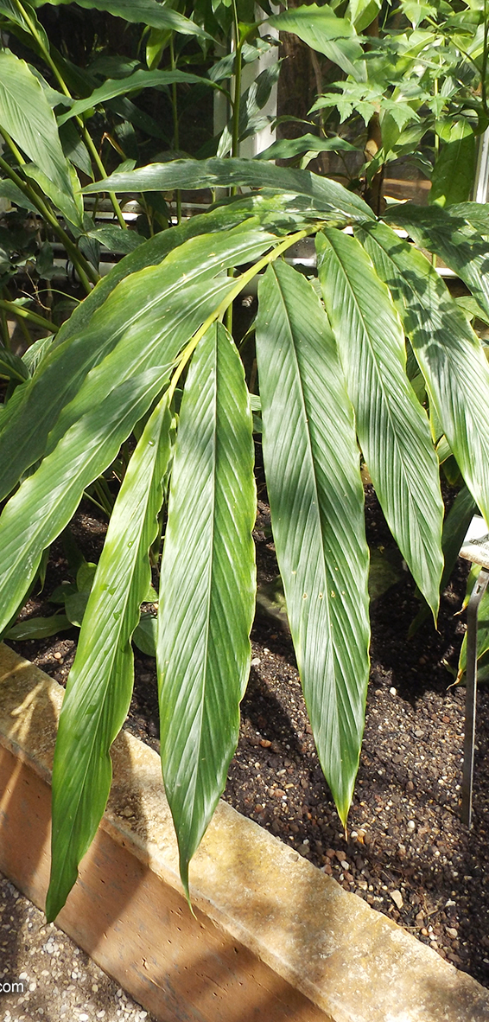
Why Cardamom?
Context:
  Nepal is an agricultural country: >60% population depends on agriculture, ~24% GDP contribution.
  Large Cardamom (*Amomum subulatum*) is a key cash crop: Nepal is the world's 3rd largest producer.
Problem:
  Cardamom cultivation threatened by fungal foliar diseases (Colletotrichum Blight, Phyllosticta Leaf Spot).
  Substantial yield losses and income reduction for farmers.
  Traditional diagnosis requires scarce, expensive, and geographically inaccessible experts.
  Early-stage disease identification is challenging visually.
Intervention:
  Smartphone application for instant diagnosis, severity estimation, and treatment advice in Nepali.

Slide 3

Research Objectives
To build and train high accuracy EfficientNetV2 - S classifier with transfer learning for four class cardamom leaf disease classification, targeting overall test accuracy above 85%.
To evaluate generally generalization, reliability, usability through 5-fold stratified cross-validation, held-out test evaluation, a background-removal ablation study, error analysis, and perturbation robustness testing under nine conditions.
To implement Grad CAM and Grad CAM++ visual explanations integrated on full stack deployment on both mobile and web applications.

Slide 4


Literature Review
From PlantVillage to Cardamom: The Undeployed Research Problem
Plant Disease Detection
Real-World Conditions
Transfer Learning
EfficientNet Architecture
Extensive research using deep
learning (e.g., Mohanty et al.
2016, Thapa et al. 2020).
Awareness of performance
degradation outside lab settings
(PlantDoc dataset).
ImageNet pretraining
consistently beneficial
(Ferentinos 2018).
EfficientNetV2 offers improved
training efficiency and accuracy
(Tan & Le 2019, Atila et al. 2021).
Explainability
Key Research Gap (Sunil et al. 2022)
My System's Differentiation
Grad-CAM and Grad-CAM++ provide visual
heatmaps (Selvaraju et al. 2017, Chattopadhay et
al. 2018).
Achieved 98.26% accuracy on cardamom disease
using EfficientNetV2-L. Lacked deployment (no
UI/API), explainability, Nepali support, rigorous
evaluation, or reproducibility.
Combines field data, explainability, 'Other' class,
multi-method eval, bilingual support, and full-
stack deployment.

Slide 5


Dataset Details
Four-Class Cardamom Leaf Dataset
Class
Images
Colletotrichum Blight
280
Phyllosticta Leaf Spot
663
Healthy
781
Other (Rejection)
~883
Total
~2,607

Slide 6
Preprocessing Pipeline and
Data Augmentation Strategy
Enhancing Data Robustness and Model Generalization
Preprocessing Steps
  Resizing images to 224x224 pixels for EfficientNetV2-S compatibility and normalizing with ImageNet statistics.
Data Augmentation (Training Set Only)
  To simulate real-world variability, employed Random Horizontal & Vertical Flip, Random Rotation (±30°), ColorJitter, and Random Affine Translation.
Methodological Choice: Training Set
Exclusion
  Data augmentation is applied exclusively to the training set to prevent bias in evaluation metrics.

Slide 7
EfficientNetV2-S with Custom Classification
Head — Architecture Design
  Model Choice Justification: Chosen over V1 V2-L (118M parameters) for superior parameter efficiency and deployment
  suitability, with comparable accuracy on ImageNet and task-specific tasks.
Training Configuration
  A schedular named ReduceLROnPlateau was used for training optimization.
  Random seed of 42 was fixed along with data split, partitioning, and initialization for reproducibility.
  Apple MPS GPU Support was used to accelerate the training the model.

Slide 8



System Architecture: Three-Tier Client–Server Design
Model Tier (Backend)
API Tier (Backend)
Client Tier (Frontend)
EfficientNetV2-S PyTorch model. Grad-
CAM / Grad-CAM++ implementation.
Severity estimation module. (Ablation:
rembg U²-Net background removal).
FastAPI REST API (Uvicorn server).
Endpoints: /predict (POST), /health
(GET). Pydantic for data validation.
Tested rigorously with Postman.
React TypeScript Web Application
(design complete, implementation
pending). React Native Mobile
Application (design complete,
implementation pending).

Slide 9
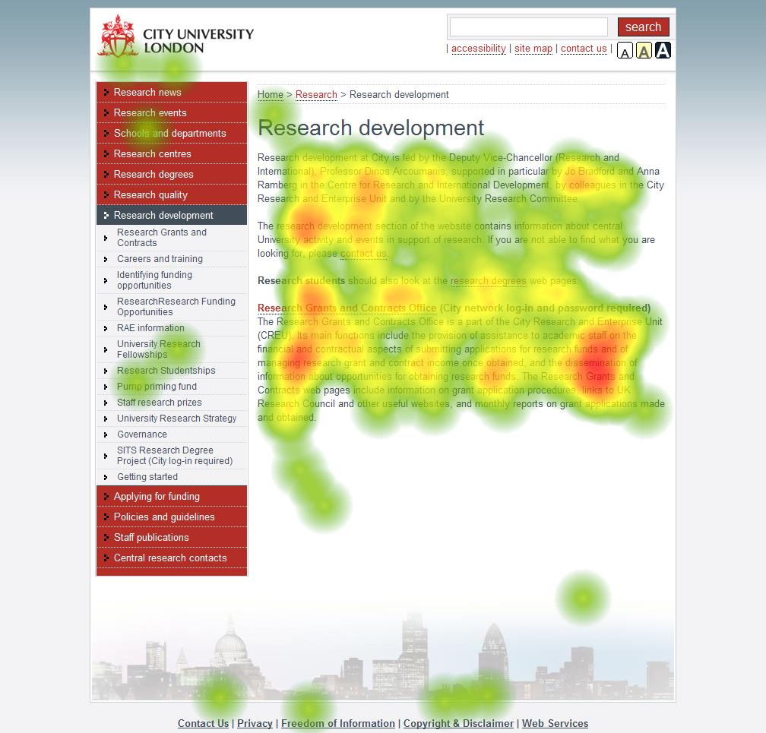
Explainability Engine: Grad-CAM
and Grad-CAM++ Implementation
Core Principle: Building trust through visual explanations.
  Heatmaps are bilinearly upsampled, color-mapped (Jet), and composited at 50% opacity. The final output is Base64 encoded and included in the API response.
  A module in `backend/app/utils/severity.py` binarizes heatmaps (threshold 0.60) and measures the proportion of activated pixels. This is mapped to a 5-stage severity scale (0: Healthy to 4: Very Severe).

Slide 10
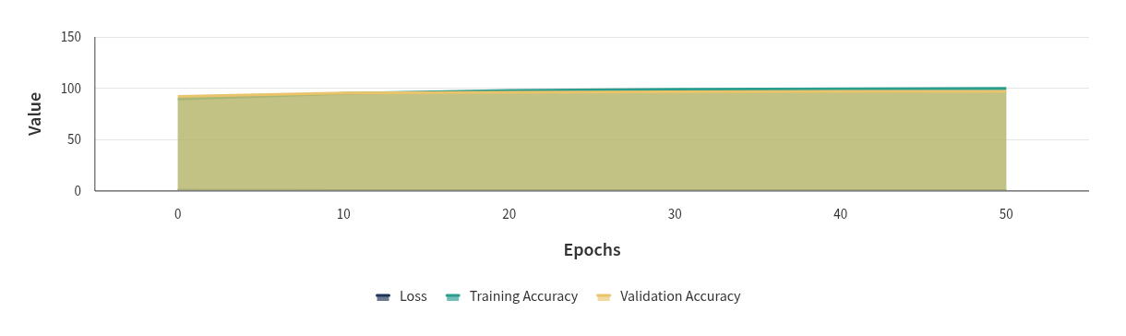
Training Behavior — Loss and Accuracy
Convergence Over 50 Epochs
Figures 3 & 4
Training and validation metrics show convergence without divergence, indicating effective
training and no overfitting. Best checkpoint saved based on minimum validation loss.

Slide 11


Test Set Evaluation: Near-Perfect Confusion Matrix
390/391 Correct (Figure 5)
Predicted Colletotrichum Blight
Predicted Healthy
Predicted Other
Predicted Phyllosticta Leaf Spot
Colletotrichum Blight
90
Healthy
83
1
Other
125
Phyllosticta Leaf Spot
92

Slide 12


Per-Class Precision, Recall, and F1-Score
All Classes Exceed Acceptance Criteria (Figure 6)
Precision
Recall
F1-Score
Notes
Colletotrichum Blight
1.000
1.000
1.000
Healthy
1.000
0.988
0.994
1 misclassification
Other
1.000
1.000
1.000
rejection class works perfectly
Phyllosticta Leaf Spot
0.989
1.000
0.995
1 False Positive from Healthy
Minimum F1 Score
0.994 (Healthy class)
Exceeds 0.70 acceptance criterion by over 0.29 F1 points.

Slide 13


5-Fold Stratified Cross-Validation
Consistent Generalization Across All Partitions (Table 8)
Fold 1
Fold 2
Fold 3
Fold 4
Fold 5
Accuracy
100.00%
100.00%
100.00%
100.00%
100.00%
Macro F1
100.00%
100.00%
100.00%
100.00%
100.00%
Standard Deviation
0.00%
0.00%
0.00%
0.00%
0.00%

Slide 14


Ablation Study: Background
Removal Degrades Performance
A Counterintuitive Finding (Table 9)
Condition
Overall Accuracy
Colletotrichum Blight F1
A (Raw)
99.74%
1.000
B (BG-Removed)
94.12%
0.861
Degradation
5.62 pp

Slide 15


Robustness Under Nine Perturbation Conditions
Blur is the Critical Vulnerability (Table 10)
Condition
Accuracy
Change
Notes
Highly Robust To:
Low Brightness (×0.4, ×0.2)
Due to Color Jitter training.
Rotation (±45°)
Generalizes beyond training augmentation.
Center Crop (75%)
Partial framing acceptable.
Critically Vulnerable To:
Gaussian Blur (Radius 3)
73.66%
-26.09 pp
Gaussian Blur (Radius 5)
47.83%
-51.92 pp
Gaussian Noise (σ=0.20)
52.94%
-46.80 pp

Slide 16


Head-to-Head Comparison:
This Study vs. Sunil et al.
(2022)
Table 12: Detailed Feature Analysis
This Study
Feature
Sunil et al. (2022)
Accuracy
98.26% (3 classes)
99.74% (4 classes)
Cross-Validation
Not Reported
100.00% ± 0.00%
Model Scale
EfficientNetV2-L (118M params)
EfficientNetV2-S (21.5M params)
Background Removal
Beneficial
Detrimental (-5.62 pp)
Explainability
None
Grad-CAM / Grad-CAM++ Integrated
Severity Estimation
None
Heuristic Module Included
Deployment
None
Full FastAPI Backend Tested
Language
English Only
Bilingual (English &amp; Nepali)
Reproducibility
No Artifacts
Open-Source GitHub Repository

Slide 17
Acknowledged Limitations
Scientific Honesty in Research
1
2
3
Dataset Provenance and
Generalization
Heuristic Severity Estimation
Network Connectivity Dependency
Severity module approximates lesion extent
from Grad-CAM activations, not validated lesion
boundaries. Outputs are explicitly marked as
heuristic.
Client-server architecture requires internet/LAN.
Remote Nepali areas have inconsistent mobile
network coverage.
All primary disease images are from a single
Kaggle dataset (Sunil et al. 2022) collected from
Indian plantations. Generalization to genuinely
new Nepalese field images is unvalidated.
4
5
Blur Sensitivity
No Formal User Study
26.09 pp accuracy degradation under blur radius 3. Smartphone cameras in the
field may produce blurry images.
Bilingual interface and system usability have not been evaluated with Nepali
farmers or extension workers.

Slide 18

Future Work
Eight Concrete Research and Development Directions
Nepal-Specific Data
Collection
Pixel-Level Lesion
Segmentation
Blur Detection & Capture
Guidance
Collecting a dedicated dataset from
Nepali plantations to validate and
improve performance.
Training a U-Net/Mask R-CNN on
annotated masks for validated
severity measurement.
Integrating real-time blur scoring
into the mobile app's capture
workflow.
Uncertainty Threshold
Calibration
Extended Disease
Taxonomy
Audio Guidance in Nepali
Providing audio-format disease
identification for improved
accessibility.
Optimizing prediction confidence
thresholds for agricultural cost-
benefit trade-offs.
Adding Katte, Chirke, and Chenthal
diseases to the classification.

Slide 19

Conclusion
From Research Model to Deployed, Interpretable, Bilingual Intelligent System
Delivered
  A validated EfficientNetV2-S classifier (99.74% accuracy, 100% CV), Grad-CAM explainability, heuristic severity estimation, and a production-ready FastAPI backend.
Outcome
  A robust foundation for a deployed, interpretable, bilingual agricultural AI system, addressing diagnostic, deployment, and language barriers for Nepali smallholder farmers.

Slide 20
Thank You
Any Question?

